Slide 1
MapReduce:
Simplified Data Processing on Large Clusters
Written By
Jeffrey Dean
Google, Inc.
Sanjay Ghemawat
Google, Inc.
Group 4
CSE 707
Summer 2022
Presented by
Syed Abed Hossain 21266019
Mobassira Atia 21266020
Ahnaf Hossain Siddique 21266021
Nishat Jahan Chowdhury 22366004
Zahid Hasan 22366016
Dipta Roy 22366040
Quazi Shahriar Haq 22366049

Slide 2
Overview
1. Introduction
5. Performance
2. Programming Model
6. Experience
3. Implementation
7. Related Work
4. Refinements
8. Conclusions

Slide 3
Syed Abed Hossain
ID - 21266019

Slide 4
Introduction
Process large amounts of raw data such as
Crawled documents
Web request logs
To compute data such as
Inverted indices
Graph structure of web documents
Summaries of crawled documents
Most frequent queries, etc.
The input data is usually large and the computations have to be distributed across hundreds or thousands of machines in order to finish in a reasonable amount of time.
The Problem

Slide 5
Introduction
MapReduce: Map + Reduce
Mapping: Applying mapping operations to each logical record to compute intermediate key/value pairs.
Reducing: Applying reduce operation to all value that shares the same key.
The Solution

Slide 6
Programming Model

Slide 7
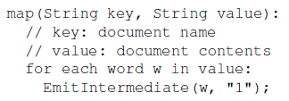
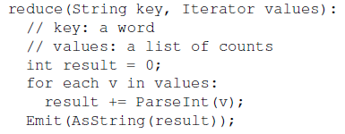
Programming Model
Map Function
Intermediate Library
Reduce Function
Written by users
takes an input pair and produces a set of intermediate key/value pairs.
Groups together all intermediate values associated with the same intermediate key I and passes them to the Reduce function.
Written by users
Accepts intermediate key and set of values
Merges together received values to form smaller set of values

Slide 8
Examples
Count of URL Access Frequency:
Processes logs of web page
Reduce function adds together all values for the same URL and outputs (URL, Total Count) pair.
Reverse Web-Link Graph:
Map function outputs (target, source) pair for each link
Reduce function concatenates the list of all source URLs associated with a given target URL and emits the pair:(target; list(source))
Distributed Sort:
Map function extracts the key from each record, and emits a (key, record) pair.
Reduce function emits all pairs unchanged.

Slide 9
Zahid Hasan
ID - 22366016

Slide 10
An Implementation of MapReduce at Google
Execution Overview
Fault Tolerance
Task Granularity

Slide 11
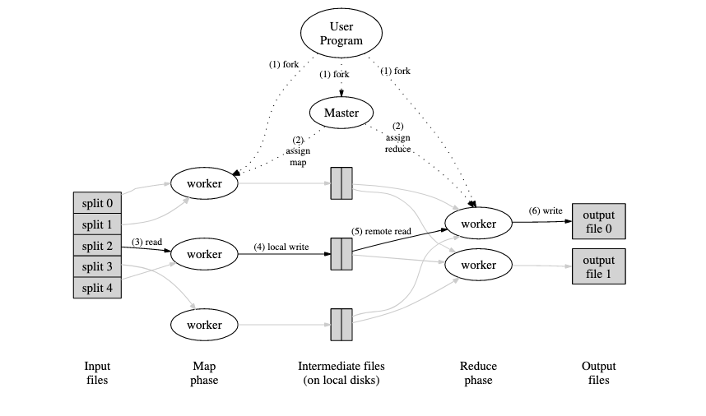
Implementation Overview

Slide 12
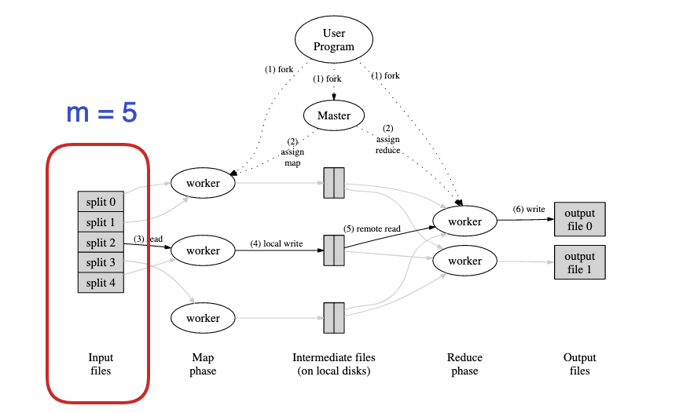
Implementation Overview
1. MapReduce library in user program splits the input files into m pieces.
It starts up many copies of the program in a cluster of machines

Slide 13
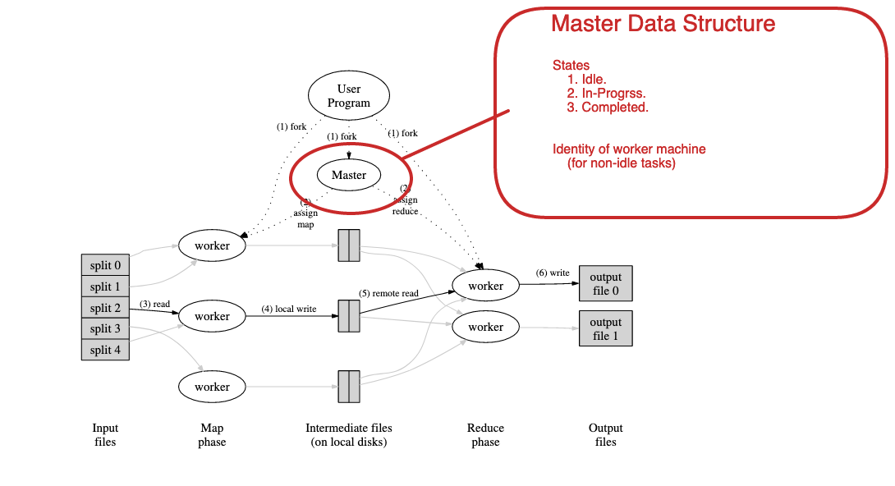
Implementation Overview
2. Master has M map tasks and R reduced tasks to assign. It assigns each one a map task or a reduce task.

Slide 14
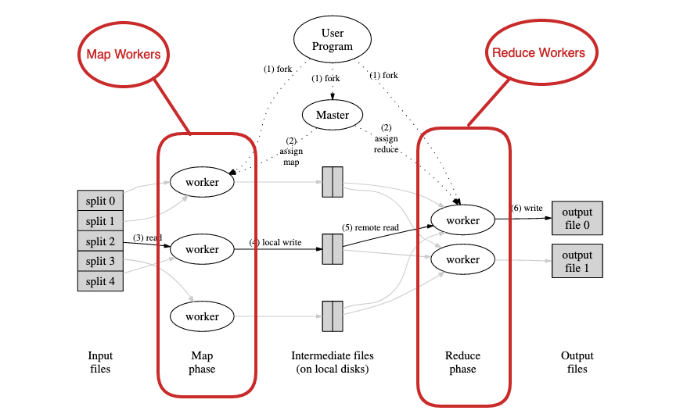
Implementation Overview

Slide 15
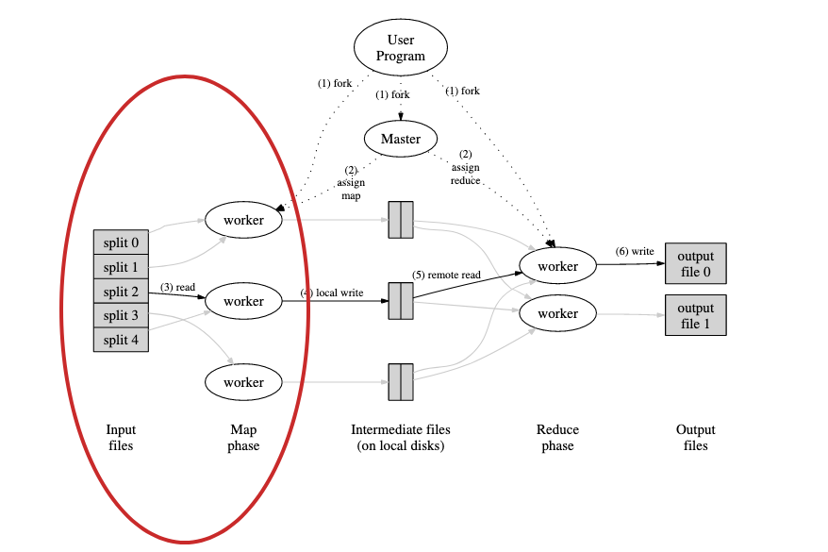
Implementation Overview
3. A Map worker reads contents from one of the splits. It parses key/value pairs from input and passes each pair to user-defined Map function.

Slide 16
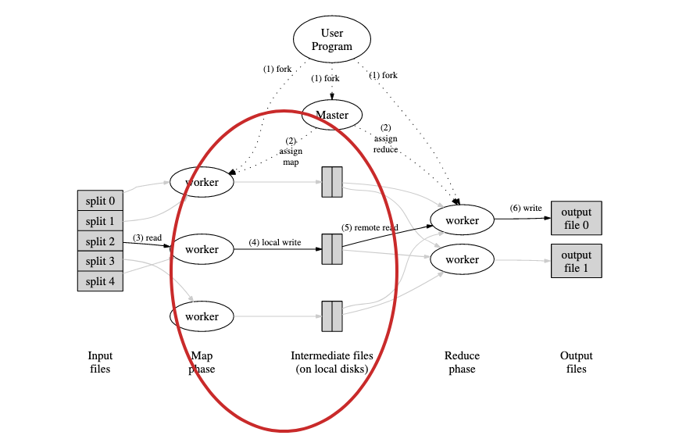
Implementation Overview
4. Intermediate key/value pairs produced by map workers are buffered in memory.
Periodically, the buffered pairs are written to local disk.
Locations of buffered pairs on the local disk are passed to master

Slide 17
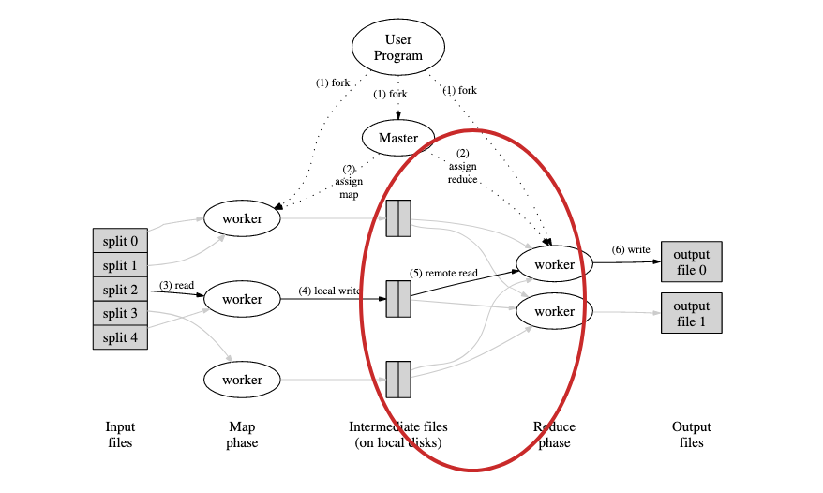
Implementation Overview
5. Reduce worker will be notified by master about the locations of intermediate key/value pairs, and uses remote procedure calls to read data from mapper’s local disk.
A sort/shuffle is done before reducer gets input, so that all occurrences of the same key are grouped together.

Slide 18
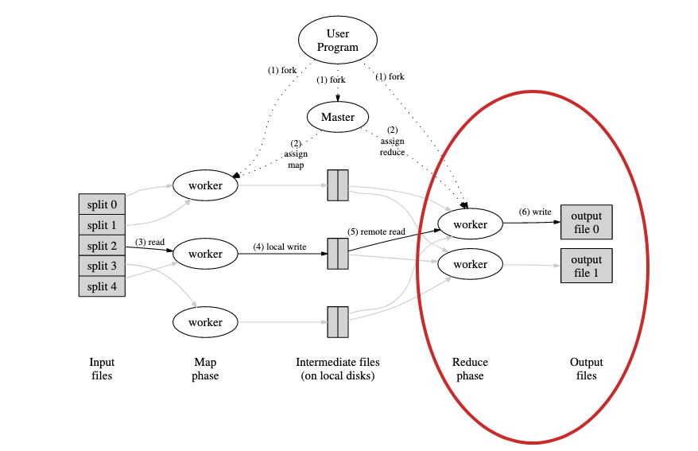
Implementation Overview
6. Reduce worker passes each unique intermediate key and the corresponding set of values to Reduce function. Output will be appended to a final output file for this partition.
When all map and reduce tasks complete, the MapReduce call in user program returns back to the user code.

Slide 19
Fault Tolerance
Map worker failure
Map tasks in-progress on a failed worker are reset to idle and become eligible for rescheduling
Map tasks completed on a failed worker are also re-executed
Output is stored on the local disk(s) of a failed machine and is therefore inaccessible
Reduce worker failure
Reduce tasks in-progress on a failed worker is reset to idle and becomes eligible for rescheduling
Completed reduce tasks do not need to be re-executed
Output stored in the global file system
Master failure
Periodic checkpoints

Slide 20
Task Granularity
M pieces of Map phase and R pieces of Reduce phase
Ideal Scenario
M and R should be much larger than the number of worker machines
Improves dynamic load balancing and speeds up recovery when a worker falls
In practice, R is usually much smaller than M
Constrained by users
Output is spread across separate files

Slide 21
Quazi Shahriar Haq
ID - 22366049

Slide 22
Refinements in Map and Reduce functions

Slide 23
Refinement Areas:
Partitioning Function
Ordering Guarantees
Combiner Function
Input and Output Types
Side-Effects
Skipping Bad Records
Local Execution
Status Information
Counters

Slide 24
Partitioning Function
Sometimes the output keys are URLs, and we want all entries for a single host to end up in the same output file. To support situations like this, the user of the MapReduce library can provide a special partitioning function.
For example:
Using “hash(Hostname(urlkey))mod R” as the partitioning function instead of “hash(key)mod R”. This causes all URLs from the same host to end up in the same output file.

Slide 25
2. Ordering Guarantees
Within a given partition, the intermediate key/value pairs are processed in increasing key order.
This ordering guarantee makes it easy to generate a sorted output file per partition, which is useful when the output file format needs to support efficient random access lookups by key, or users of the output find it convenient to have the data sorted.

Slide 26
3. Combiner Function
In some cases, there is significant repetition in the intermediate keys produced by each map task, and the user specified Reduce function is commutative and associative.
In Combiner Function, the user is allowed to specify an optional Combiner function that does partial merging of the data before it is sent over the network.
Hence, this partial combining significantly speeds up certain classes of MapReduce operations.

Slide 27
4. Input and Output Types
The MapReduce library provides support for reading input data in several different formats.
Users can add support for a new input type by providing an implementation of a simple reader interface, though most users just use one of a small number of predefined input types.
In a similar fashion, a set of output types are provided for producing data in different formats. Hence, it is easy for users to code for adding support for new output types.

Slide 28
5. Side-Effects
In some cases, users of MapReduce have found it convenient to produce auxiliary files as additional outputs from their map and/or reduce operators.
However, the refinements do not provide support for atomic two-phase commits of multiple output files produced by a single task.
Therefore, tasks that produce multiple output files with cross-file consistency requirements should be deterministic.
This restriction has never been an issue in practice.

Slide 29
6. Skipping Bad Records
Sometimes there are bugs in user code that cause the Map or Reduce functions to crash deterministically on certain records. Such bugs prevent a MapReduce operation from completing.
However, sometimes it is acceptable to ignore a few records.
One of the refinements produces an optional mode of execution where the MapReduce library detects which records cause deterministic crashes and skips these records in order to make forward progress.

Slide 30
7. Local Execution
Sometimes debugging problems in Map or Reduce functions become difficult, since the actual computation happens in a distributed system, often on several thousand machines, with work assignment decisions made dynamically by the master.
A new development in an alternative implementation of the MapReduce library that sequentially executes all of the work for a MapReduce operation on the local machine.

Slide 31
8. Status Information
The master runs an internal HTTP server and exports a set of status pages for human consumption. The status pages show the progress of the computation.
The user can use this data to predict how long the computation will take, and whether or not more resources should be added to the computation.
This information is useful when attempting to diagnose bugs in the user code.

Slide 32
9. Counters
The MapReduce library provides a counter facility to count occurrences of various events.
The counter values from individual worker machines are periodically propagated to the master
This helps the master to eliminate the effects of duplicate executions of the same map or reduce task to avoid double counting.
Users are also benefited to have the counter facility for sanity checking the behavior of MapReduce operations.

Slide 33
Dipta Roy
22366040

Slide 34
Large-scale Google Indexing
Smaller and easy to understand code as fault tolerance, distribution remains hidden within MapReduce Library
MapReduce library can keep conceptually unrelated computation separate.
Do not need operator intervention during computational hiccups.
Easy to add new machines to improve performance.

Slide 35
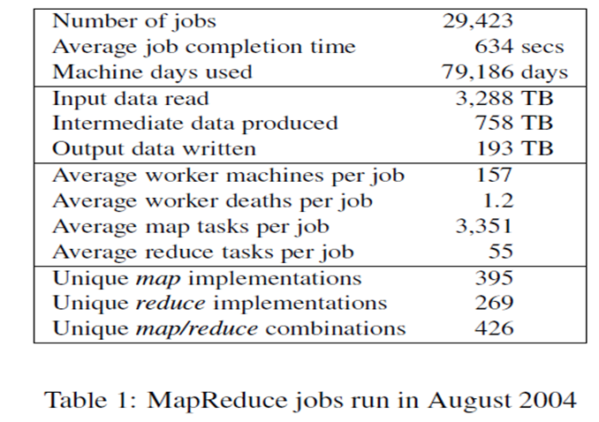
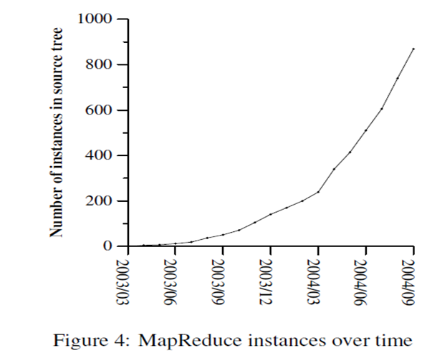
Experience on MapReduce Library
§
MapReduce Library produce logs statistics of number of
computational resources used for at the end of each job.

Slide 36
Ahnaf Hossain Siddique
ID - 21266021

Slide 37
Performance of MapReduce

Slide 38
Cluster Configuration
The machines were arranged in a two-level tree-shaped switched network.
Programs are executed on a cluster.
Less round trip time.

Slide 39
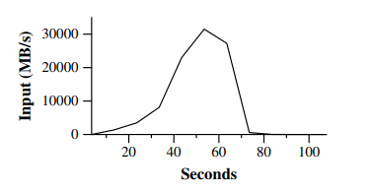
Grep
Grep program scans through 1010 100-byte records, searching for a relatively rare three-character pattern.

Slide 40
Sort
The sort program sorts 1010 100-byte records.
The sorting program consists of less than 50 lines of user code.

Slide 41
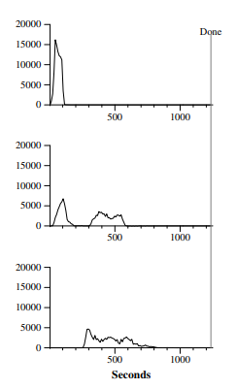
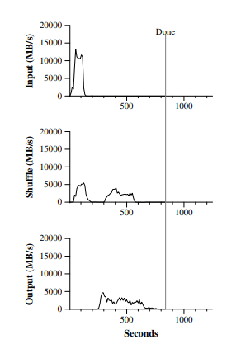
Effect of Backup Tasks
The entire computation takes 1283 seconds, an increase of 44% in elapsed time.

Slide 42
Machine Failures

Slide 43
Nishat Jahan Chowdhury
ID - 22366004

Slide 44
Related Work
MapReduce can be considered a simplified model among some models based on our experience
A key difference between other systems and MapReduce is MapReduce exploits a restricted programming model
The MapReduce implementation relies on an in-house cluster management system
Our backup mechanism is similar to the eager scheduling mechanism employed in the Charlotte System
The River System tries to provide good average case performance like MapReduce even in the presence of non-uniformalities

Slide 45
Cont..
BAD-FS has a different programming model from MapReduce, it targets the execution of jobs across a wide area network
TACC system is like MapReduce which simplify construction of highly available networked services

Slide 46
Mobassira Atia
ID - 21266020

Slide 47
Overview & Conclusion

Slide 48
Overview
Implementation reasons at Google:
Easy to use, even for programmers without experience with parallel and distributed systems.
Large variety of problems are easily expressible as MapReduce computations.
Implementation of MapReduce that scales to large clusters of machines comprising thousands of machines.

Slide 49
Lessons
Limiting the programming paradigm makes it simple to parallelize and distribute calculations.
Network bandwidth is an in limited supply.
Redundant execution can be utilized to mitigate the impact of slow computers.

Slide 50
THANK YOU…

